Slide 1


Slide 2

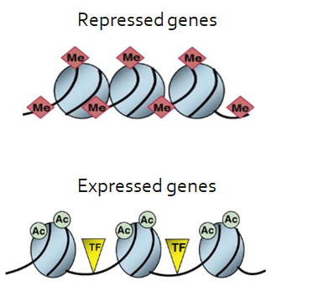
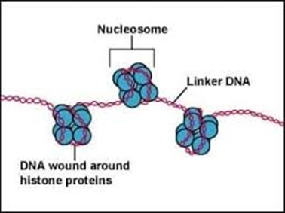
INTRODUCTION
DNA + Histones → Nucleosomes
Nucleosomes as access barriers

Slide 3
PROJECT DESCRIPTION
GOALS
Acquiring an extensive background on current state-of-the-art computational tools and pipelines for the analysis and interpretation of ChIP-seq data.
Understanding nucleosome dynamics based on ChIP-seq.
Reproducing time-ChIP analysis to assess histone H3.3 turnover genome-wide during differentiation of mouse ESCs (Aimee, 2016)
METHODS
ChIP-seq analysis
Turnover index (TI) calculation
Identification of top TI regions
Detecting differences in TI between ESCs and NSCs

Slide 4
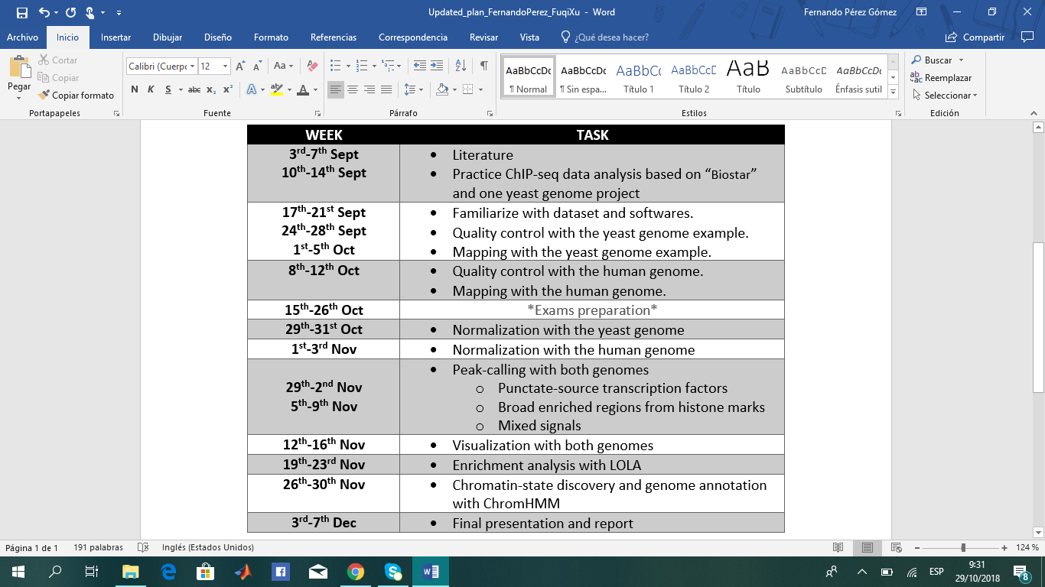
PROJECT PLAN AND PROGRESS

Slide 5
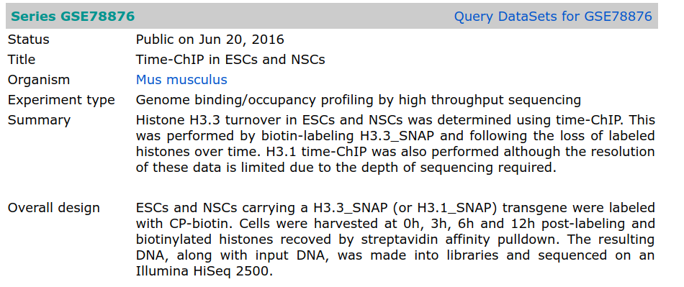
DATA DESCRIPTION
SRR3203856 ESC_H33_00h_rep1
SRR3203857 ESC_H33_03h_rep1
SRR3203858 ESC_H33_06h_rep1
SRR3203859 ESC_H33_12h_rep1
SRR3203860 ESC_H33_inp_rep1

Slide 6
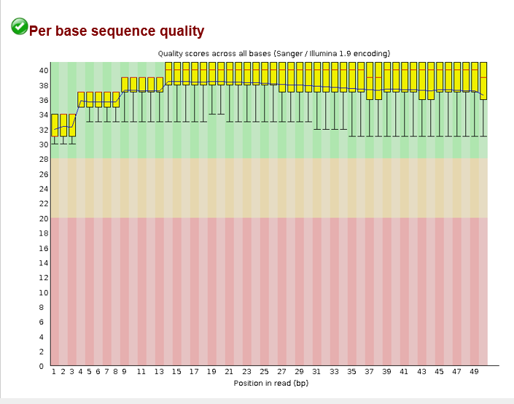
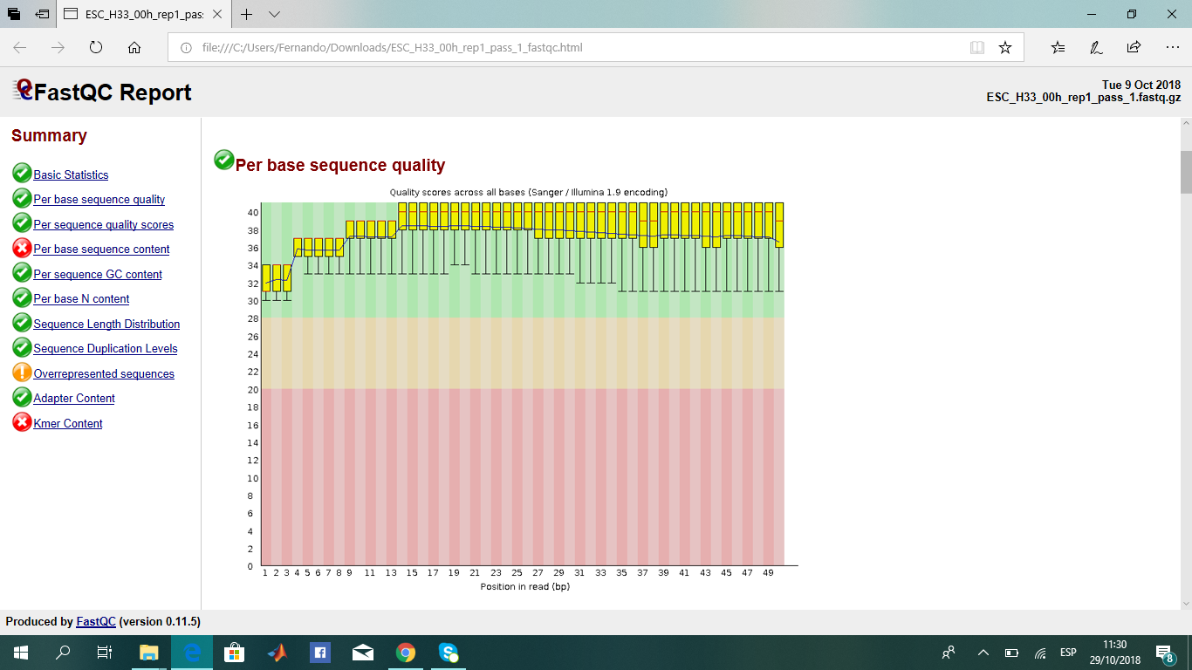
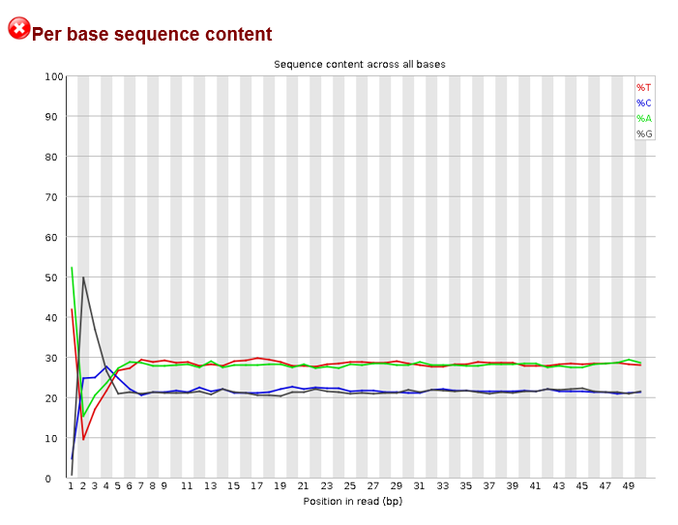
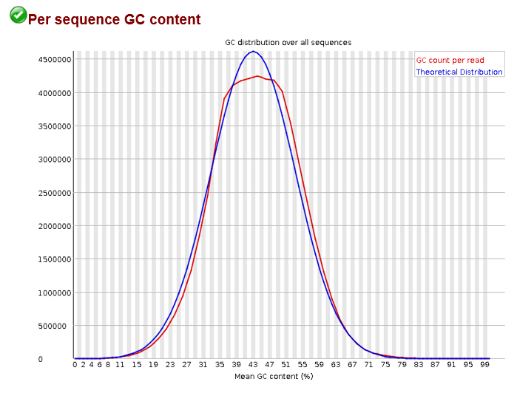
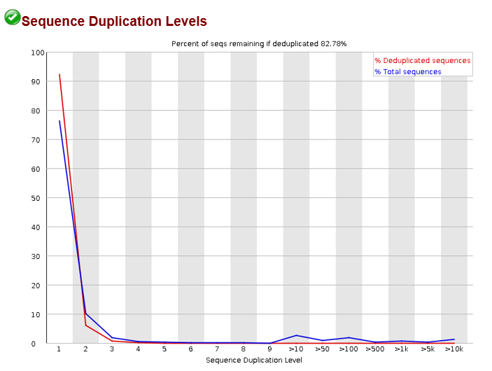
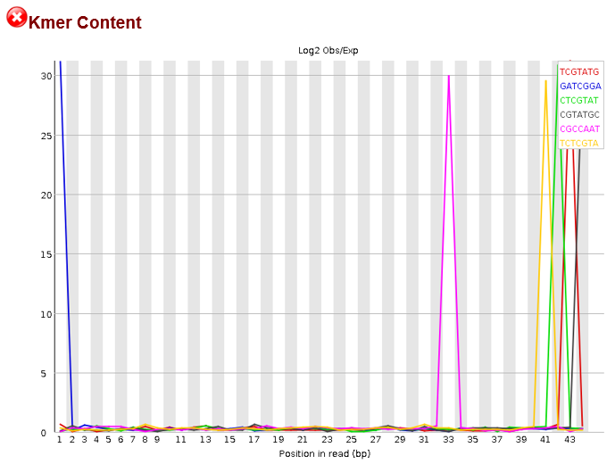
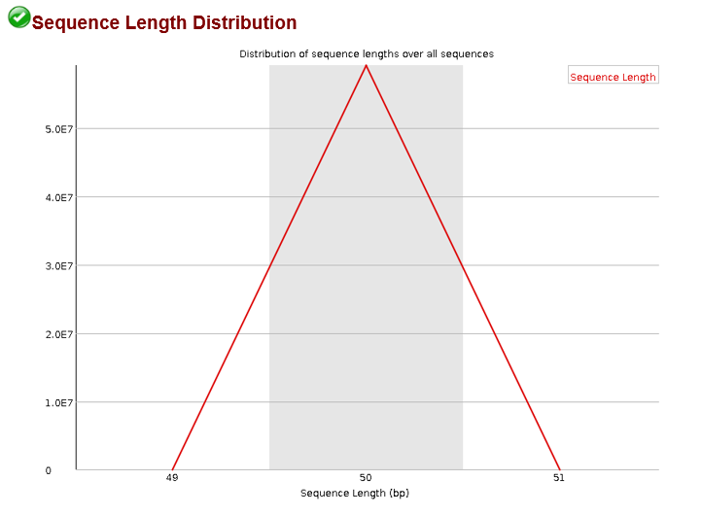
QUALITY CONTROL - FASTQC
Quality control on raw sequence data from HTS

Slide 7
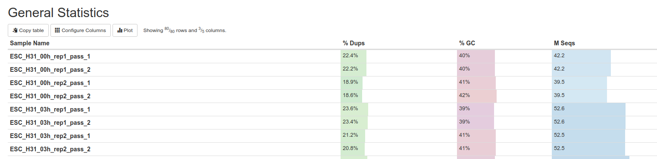
QUALITY CONTROL - MULTIQC
Single summary report visualizing results across all samples
Fast
Reliable
Easy extension and customization

Slide 8
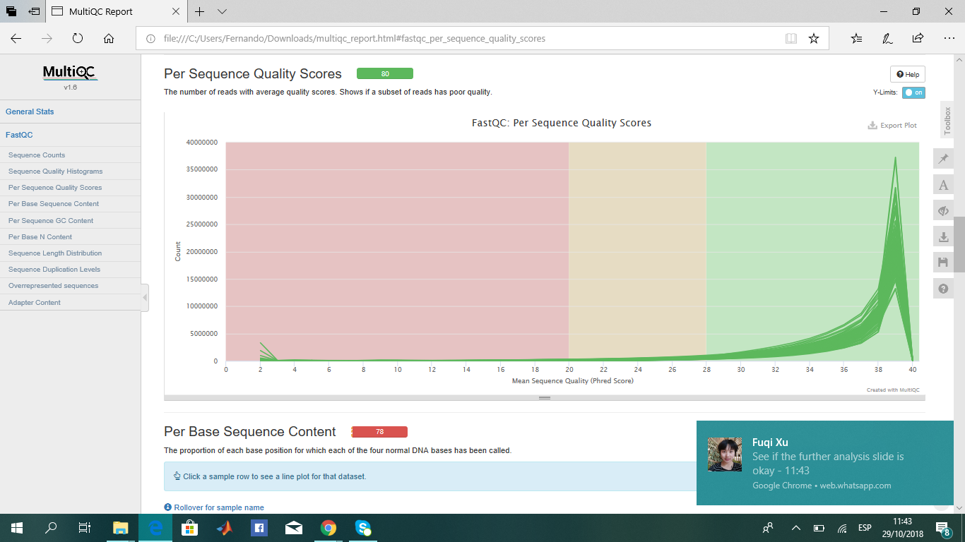
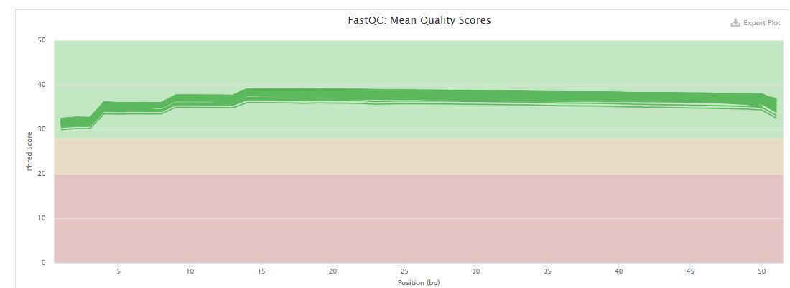
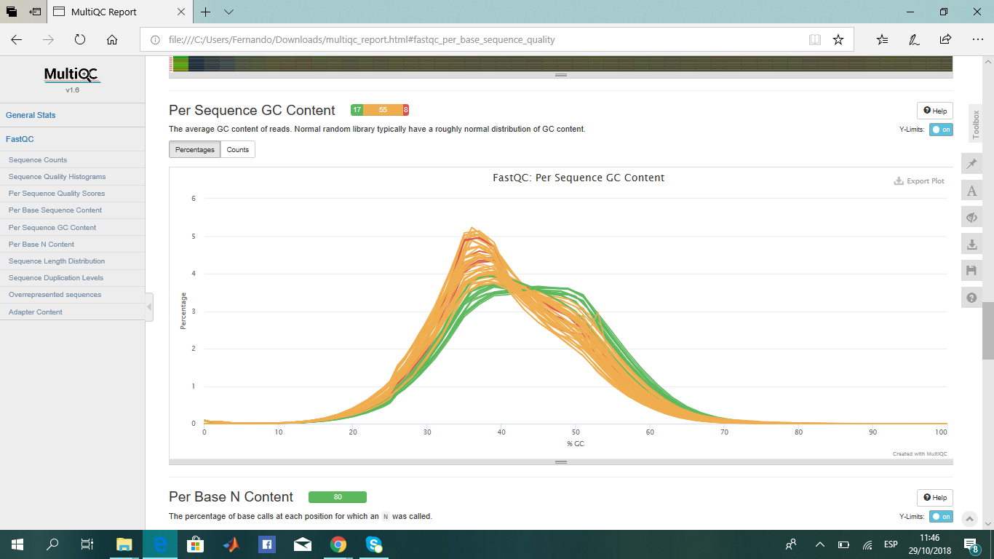
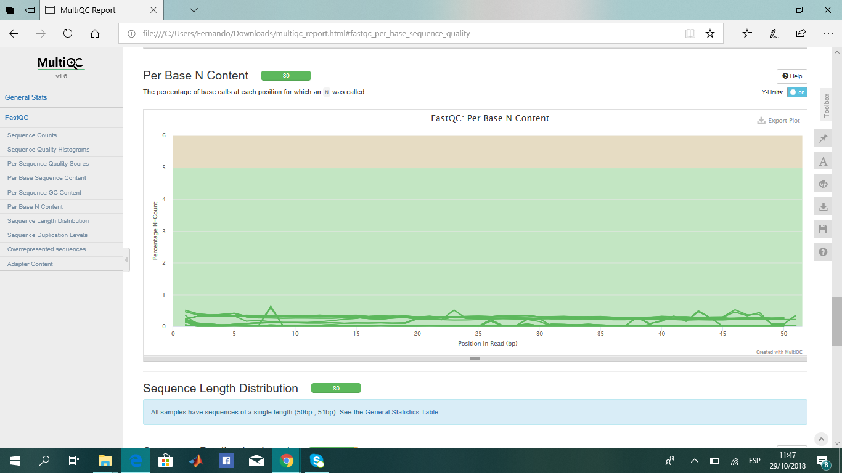
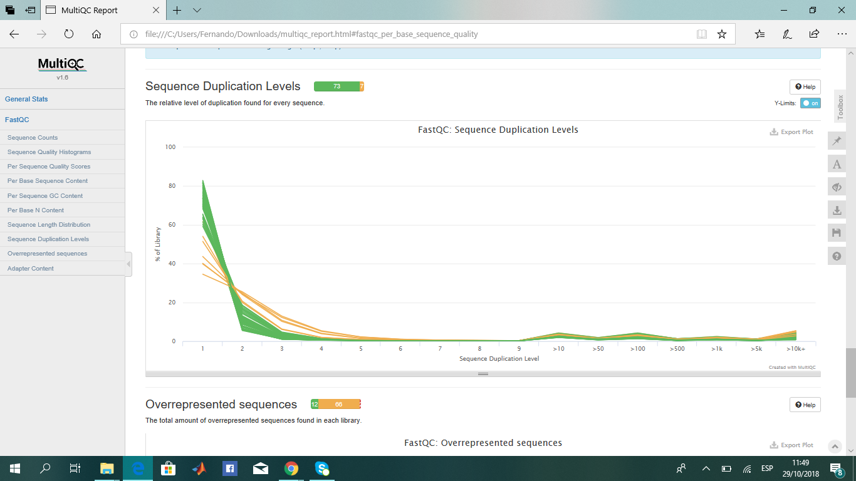
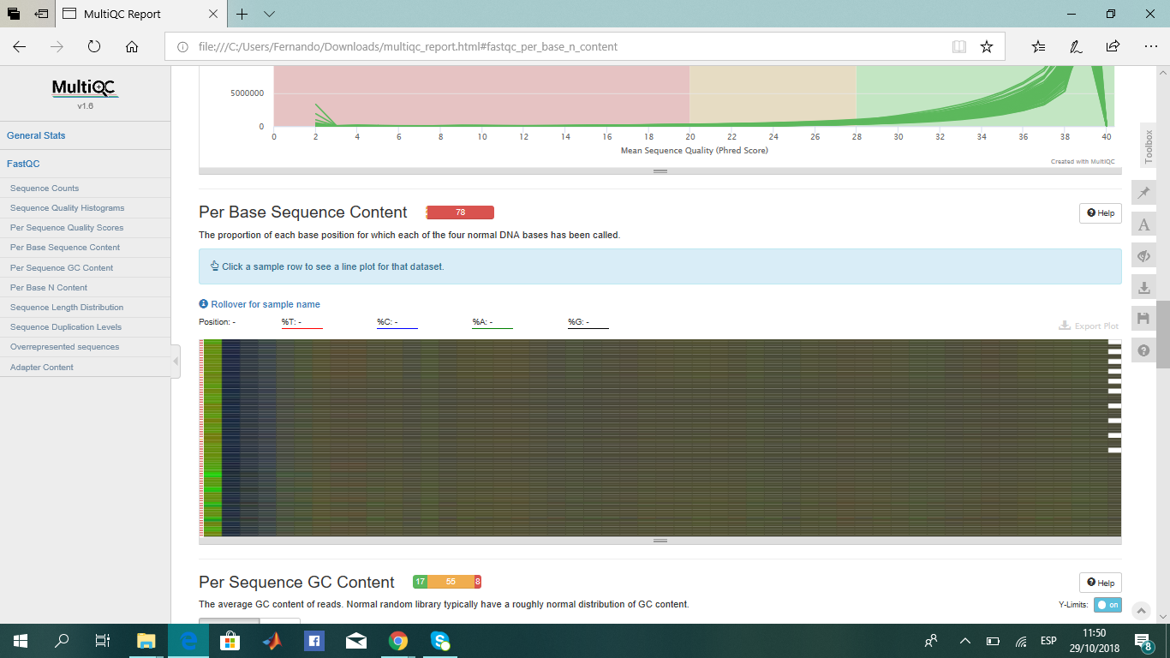
QUALITY CONTROL - MULTIQC

Slide 9
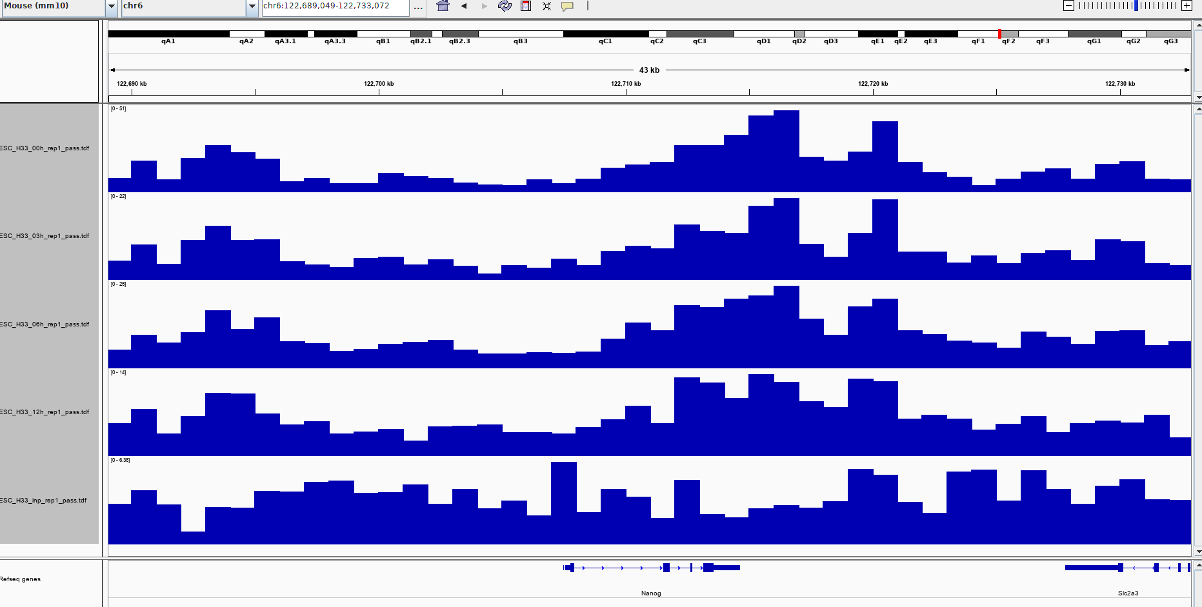
ALIGNMENT VISUALIZATION

Slide 10
Further Analysis
Turnover index(TI) calculation
Identification of top TI regions
Detecting differences in TI between ESCs and NSCs
Comparing the dynamic change of enhancers and active genes during differentiation

Slide 11
PROJECT ISSUES
A supercomputer (Uppsala cluster)

